Slide 1
Chapter 11 Inheritance

Slide 2
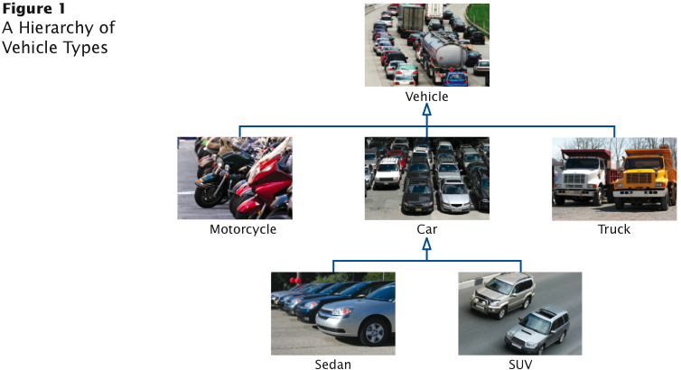
Inheritance Hierarchy

Slide 3
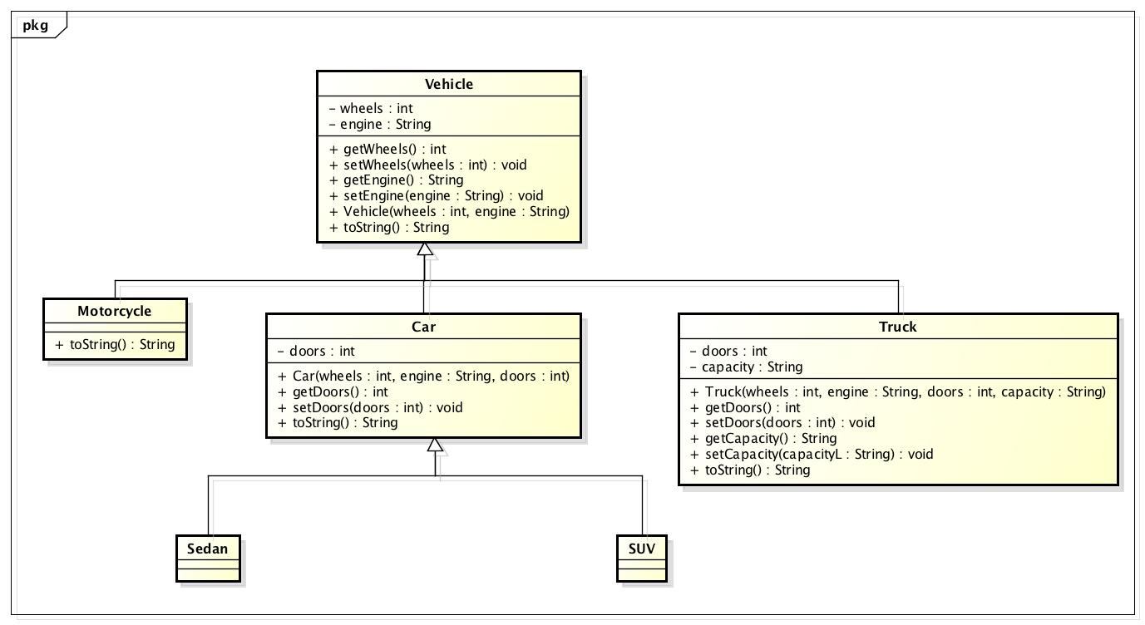
Inheritance UML

Slide 4
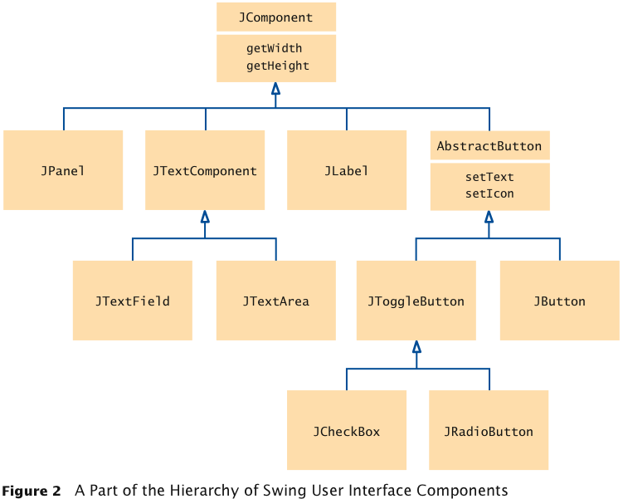
Inheritance Hierarchy
Set of classes can form an inheritance hierarchy
Classes representing the most general concepts are near the root, more specialized classes towards the branches:
Notes:
UML notation to model class diagram.
Solid line with closed hollow arrowhead
Arrow points to superclass (parent). Superclass is more general of the class.

Slide 5
Inheritance Hierarchy
Superclass (parent)
more general class
Subclass (child)
more specialized class that inherits from the superclass
Example: JPanel is a subclass of JComponent

Slide 6
Example
Different account types:
Checking account:
No interest
Small number of free transactions per month
Charges transaction fee for additional transactions
Savings account:
Earns interest that compounds monthly
Superclass: BankAccount
Subclasses: CheckingAccount & SavingsAccount

Slide 7
Inheritance
Behavior of account classes:
All support getBalance method
Also support deposit and withdraw methods, but implementation details differ
Checking account needs a method deductFees to deduct the monthly fees and to reset the transaction counter
Checking account must override deposit and withdraw methods to count the transactions

Slide 8
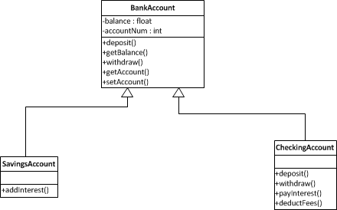
BankAccount UML

Slide 9
Inheritance
Mechanism for extending existing classes by adding instance variables and methods:
class SavingsAccount extends BankAccount
{
added instance variables
new methods
}

Slide 10
Inheritance
A subclass inherits the methods of its superclass:
SavingsAccount collegeFund = new SavingsAccount(10);
// Savings account with 10% interest
collegeFund.deposit(500);
// OK to use BankAccount method with SavingsAccount object

Slide 11
Subclass
Specify added instance variables, added methods, and changed or overridden methods:
public class SavingsAccount extends BankAccount
{
private double interestRate;
public SavingsAccount(double rate)
{
Constructor implementation
}
public void addInterest()
{
Method implementation
}
}

Slide 12
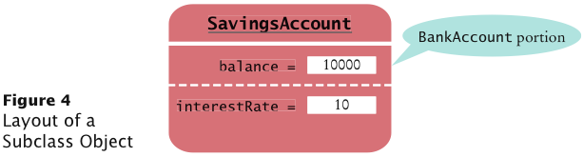
Inheritance
Instance variables declared in the superclass are present in subclass objects
SavingsAccount object inherits the balance instance variable from BankAccount, and gains one additional instance variable, interestRate:

Slide 13
Inheritance
Subclass has no access to private members of its superclass
Encapsulation: methods call getter/setter rather than directly accessing variables in superclass
Inheriting from a class differs from implementing an interface: the subclass inherits behavior from the superclass

Slide 14
Common Errors
A subclass has no access to the private instance variables of the superclass:
public class SavingsAccount extends BankAccount
{
public void addInterest()
{
double interest = getBalance() * interestRate / 100;
balance = balance + interest; // Error
}
. . .
}
Don’t solve problem by adding a local variable balance. Shadows variable intended.

Slide 15
Overriding Methods
A subclass method overrides a superclass method if it has the same name and parameter types as a superclass method
When such a method is applied to a subclass object, the overriding method is executed

Slide 16
Example Override
deposit and withdraw of CheckingAccount class override deposit and withdraw of BankAccount
public class BankAccount
{
. . .
public void deposit(double amount) { . . . }
public void withdraw(double amount) { . . . }
public double getBalance() { . . . }
}
public class CheckingAccount extends BankAccount
{
. . .
public void deposit(double amount) { . . . }
public void withdraw(double amount) { . . . }
public void deductFees() { . . . }
}

Slide 17
Overriding Methods
Problem: Overriding method deposit can't simply add amount to balance:
public class CheckingAccount extends BankAccount
{
. . .
public void deposit(double amount)
{
transactionCount++;
// Now add amount to balance
balance = balance + amount; // Error
}
}
If you want to modify a private superclass instance variable, you must use a public method of the superclass

Slide 18
Overriding Methods
Use the super reserved word to call a method of the superclass:
public class CheckingAccount extends BankAccount
{
public void deposit(double amount)
{
transactionCount++;
// Now add amount to balance
super.deposit
}
}

Slide 19
Overriding vs. Overloading

Slide 20
Subclass Construction
To call the superclass constructor, use the super reserved word in the first statement of the subclass constructor:
public class CheckingAccount extends BankAccount
{
public CheckingAccount(double initialBalance)
{
// Construct superclass
super(initialBalance);
// Initialize transaction count
transactionCount = 0;
}
...
}

Slide 21
Subclass Construction
When subclass constructor doesn't call superclass constructor, the superclass must have a constructor with no parameters
If, however, all constructors of the superclass require parameters, then the compiler reports an error

Slide 22
Converting Subclass to Superclass
OK to convert subclass reference to superclass reference:
SavingsAccount collegeFund = new SavingsAccount(10);
BankAccount anAccount = collegeFund;
Object anObject = collegeFund;
The three object references stored in collegeFund, anAccount, and anObject all refer to the same object of type SavingsAccount

Slide 23
Converting Subclass to Superclass
Superclass references don’t know the full story:
anAccount.deposit(1000); // OK
anAccount.addInterest();
// Not a method of the class to which anAccount
// belongs
Why would anyone want to know less about an object?
Reuse code that knows about the superclass but not the subclass:
public void transfer(double amount, BankAccount other)
{
withdraw(amount);
other.deposit(amount);
}
Can be used to transfer money from any type of BankAccount
Notes:
anAccount is a BankAccount

Slide 24
Subclass to Superclass Conversion
Occasionally you need to convert from a superclass reference to a subclass reference:
BankAccount anAccount = (BankAccount) anObject;
Dangerous cast: Throws an exception if not correct type
instanceof: Tests whether an object belongs to a particular type:
if (anObject instanceof BankAccount)
{
BankAccount anAccount = (BankAccount) anObject;
}

Slide 25
Protected Access
Protected -
can be accessed by all subclasses
and by all classes in the same package
Allows CheckingAccount methods access to the balance instance variable of the superclass BankAccount:
public class BankAccount
{
protected double balance;
}

Slide 26
Protected Access
Designer of superclass has no control over subclasses:
Any of the subclass methods can corrupt the superclass data
Classes with protected instance variables are hard to modify — the protected variables cannot be changed, because someone somewhere out there might have written a subclass whose code depends on them
Best to leave all data private and provide accessor methods for the data

Slide 27
Accessibility Summary

Slide 28
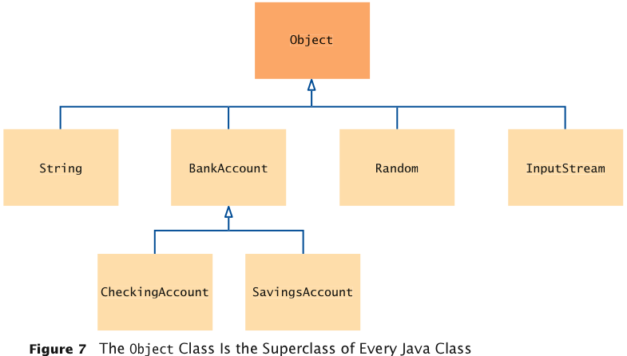
Object
All classes extend Object

Slide 29
Object Methods
Most useful methods:
String toString()
boolean equals(Object otherObject)
Object clone()
Good idea to override these methods in your classes

Slide 30
Object.toString()
Object.toString prints class name and the hash code of the object:
BankAccount momsSavings = new BankAccount(5000);
String s = momsSavings.toString();
// Sets s to something like "BankAccount@d24606bf"

Slide 31
Overriding
What is overriding?
Creating the same method and signature in a subclass that is declared in the superclass

Slide 32
Overriding toString()
Returns a string representation of the object
Useful for debugging:
Rectangle box = new Rectangle(5, 10, 20, 30);
String s = box.toString();
// Sets s to "java.awt.Rectangle[x=5,y=10,width=20, // height=30]"
toString is called whenever you concatenate a string with an object:
"box=" + box;
// Result: "box=java.awt.Rectangle[x=5,y=10,width=20, // height=30]"

Slide 33
Override equals()
Cannot change parameter type; use a cast instead:
public class Coin
{
...
public boolean equals(Object otherObject)
{
Coin other = (Coin) otherObject;
return name.equals(other.name) && value == other.value;
}
}

Slide 34
clone()
Copying an object reference gives two references to same object:
BankAccount account = newBankAccount(1000);
BankAccount account2 = account;
account2.deposit(500); // Now both account and account2
// refer to a bank account with a balance of 1500
Sometimes, need to make a copy of the object:

Slide 35
clone method
Makes a new object with the same state as the existing object
Use clone:
BankAccount clonedAccount =
(BankAccount) account.clone();
Must cast return value because return type is Object
clone() makes a shallow copy

Slide 36
clone method
Does not systematically clone all subobjects
Must be used with caution
It is declared as protected; prevents from accidentally calling x.clone() if the class to which x belongs hasn’t redefined clone to be public

Slide 37
Are superclass’s Constructor Inherited?
No. They are not inherited.
They are invoked explicitly or implicitly.
Explicitly using the super keyword.
A constructor is used to construct an instance of a class. Unlike properties and methods, a superclass's constructors are not inherited in the subclass. They can only be invoked from the subclasses' constructors, using the keyword super. If the keyword super is not explicitly used, the superclass's no-arg constructor is automatically invoked.

Slide 38
Superclass’s Constructor Is Always Invoked
A constructor may invoke an overloaded constructor or its superclass’s constructor. If none of them is invoked explicitly, the compiler puts super() as the first statement in the constructor. For example,

Slide 39
Using the Keyword super
The keyword super refers to the superclass of the class in which super appears. This keyword can be used in two ways:
To call a superclass constructor
To call a superclass method

Slide 40
Constructor Chaining
Constructing an instance of a class invokes all the superclasses’ constructors along the inheritance chain. This is known as constructor chaining.
public class Faculty extends Employee {
public static void main(String[] args) {
new Faculty();
}
public Faculty() {
System.out.println("(4) Faculty's no-arg constructor is invoked");
}
}
class Employee extends Person {
public Employee() {
this("(2) Invoke Employee’s overloaded constructor");
System.out.println("(3) Employee's no-arg constructor is invoked");
}
public Employee(String s) {
System.out.println(s);
}
}
class Person {
public Person() {
System.out.println("(1) Person's no-arg constructor is invoked");
}
}

Slide 41
Trace Execution
animation
public class Faculty extends Employee {
public static void main(String[] args) {
new Faculty();
}
public Faculty() {
System.out.println("(4) Faculty's no-arg constructor is invoked");
}
}
class Employee extends Person {
public Employee() {
this("(2) Invoke Employee’s overloaded constructor");
System.out.println("(3) Employee's no-arg constructor is invoked");
}
public Employee(String s) {
System.out.println(s);
}
}
class Person {
public Person() {
System.out.println("(1) Person's no-arg constructor is invoked");
}
}
1. Start from the main method

Slide 42
Trace Execution
animation
public class Faculty extends Employee {
public static void main(String[] args) {
new Faculty();
}
public Faculty() {
System.out.println("(4) Faculty's no-arg constructor is invoked");
}
}
class Employee extends Person {
public Employee() {
this("(2) Invoke Employee’s overloaded constructor");
System.out.println("(3) Employee's no-arg constructor is invoked");
}
public Employee(String s) {
System.out.println(s);
}
}
class Person {
public Person() {
System.out.println("(1) Person's no-arg constructor is invoked");
}
}
2. Invoke Faculty constructor

Slide 43
Trace Execution
animation
public class Faculty extends Employee {
public static void main(String[] args) {
new Faculty();
}
public Faculty() {
System.out.println("(4) Faculty's no-arg constructor is invoked");
}
}
class Employee extends Person {
public Employee() {
this("(2) Invoke Employee’s overloaded constructor");
System.out.println("(3) Employee's no-arg constructor is invoked");
}
public Employee(String s) {
System.out.println(s);
}
}
class Person {
public Person() {
System.out.println("(1) Person's no-arg constructor is invoked");
}
}
3. Invoke Employee’s no-arg constructor

Slide 44
Trace Execution
animation
public class Faculty extends Employee {
public static void main(String[] args) {
new Faculty();
}
public Faculty() {
System.out.println("(4) Faculty's no-arg constructor is invoked");
}
}
class Employee extends Person {
public Employee() {
this("(2) Invoke Employee’s overloaded constructor");
System.out.println("(3) Employee's no-arg constructor is invoked");
}
public Employee(String s) {
System.out.println(s);
}
}
class Person {
public Person() {
System.out.println("(1) Person's no-arg constructor is invoked");
}
}
4. Invoke Employee(String) constructor

Slide 45
Trace Execution
animation
public class Faculty extends Employee {
public static void main(String[] args) {
new Faculty();
}
public Faculty() {
System.out.println("(4) Faculty's no-arg constructor is invoked");
}
}
class Employee extends Person {
public Employee() {
this("(2) Invoke Employee’s overloaded constructor");
System.out.println("(3) Employee's no-arg constructor is invoked");
}
public Employee(String s) {
System.out.println(s);
}
}
class Person {
public Person() {
System.out.println("(1) Person's no-arg constructor is invoked");
}
}
5. Invoke Person() constructor

Slide 46
Trace Execution
animation
public class Faculty extends Employee {
public static void main(String[] args) {
new Faculty();
}
public Faculty() {
System.out.println("(4) Faculty's no-arg constructor is invoked");
}
}
class Employee extends Person {
public Employee() {
this("(2) Invoke Employee’s overloaded constructor");
System.out.println("(3) Employee's no-arg constructor is invoked");
}
public Employee(String s) {
System.out.println(s);
}
}
class Person {
public Person() {
System.out.println("(1) Person's no-arg constructor is invoked");
}
}
6. Execute println

Slide 47
Trace Execution
animation
public class Faculty extends Employee {
public static void main(String[] args) {
new Faculty();
}
public Faculty() {
System.out.println("(4) Faculty's no-arg constructor is invoked");
}
}
class Employee extends Person {
public Employee() {
this("(2) Invoke Employee’s overloaded constructor");
System.out.println("(3) Employee's no-arg constructor is invoked");
}
public Employee(String s) {
System.out.println(s);
}
}
class Person {
public Person() {
System.out.println("(1) Person's no-arg constructor is invoked");
}
}
7. Execute println

Slide 48
Trace Execution
animation
public class Faculty extends Employee {
public static void main(String[] args) {
new Faculty();
}
public Faculty() {
System.out.println("(4) Faculty's no-arg constructor is invoked");
}
}
class Employee extends Person {
public Employee() {
this("(2) Invoke Employee’s overloaded constructor");
System.out.println("(3) Employee's no-arg constructor is invoked");
}
public Employee(String s) {
System.out.println(s);
}
}
class Person {
public Person() {
System.out.println("(1) Person's no-arg constructor is invoked");
}
}
8. Execute println

Slide 49
Trace Execution
animation
public class Faculty extends Employee {
public static void main(String[] args) {
new Faculty();
}
public Faculty() {
System.out.println("(4) Faculty's no-arg constructor is invoked");
}
}
class Employee extends Person {
public Employee() {
this("(2) Invoke Employee’s overloaded constructor");
System.out.println("(3) Employee's no-arg constructor is invoked");
}
public Employee(String s) {
System.out.println(s);
}
}
class Person {
public Person() {
System.out.println("(1) Person's no-arg constructor is invoked");
}
}
9. Execute println

Slide 50
Final
7/24 2:00 – 4:30

